Slide 1
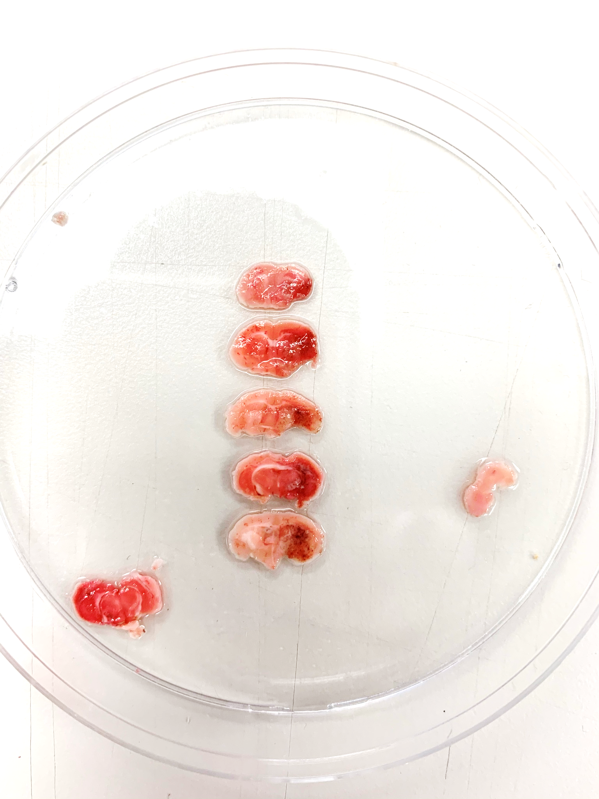
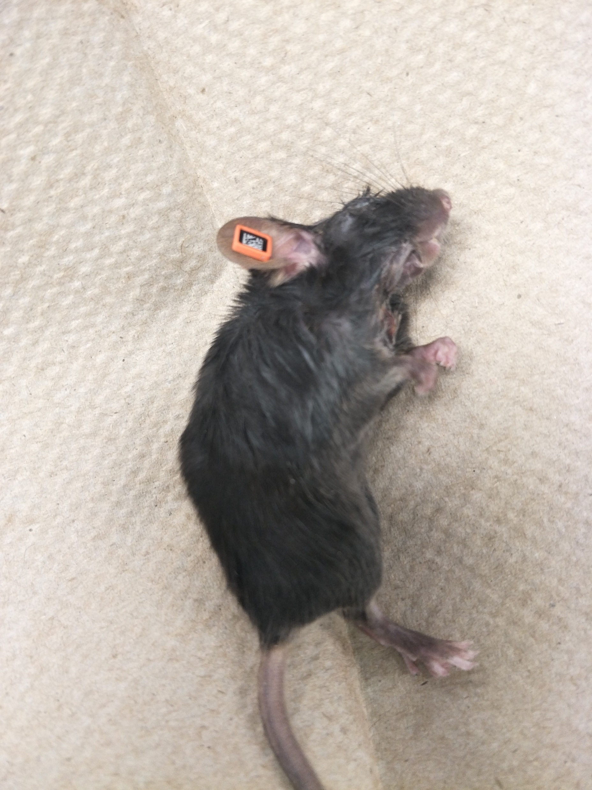
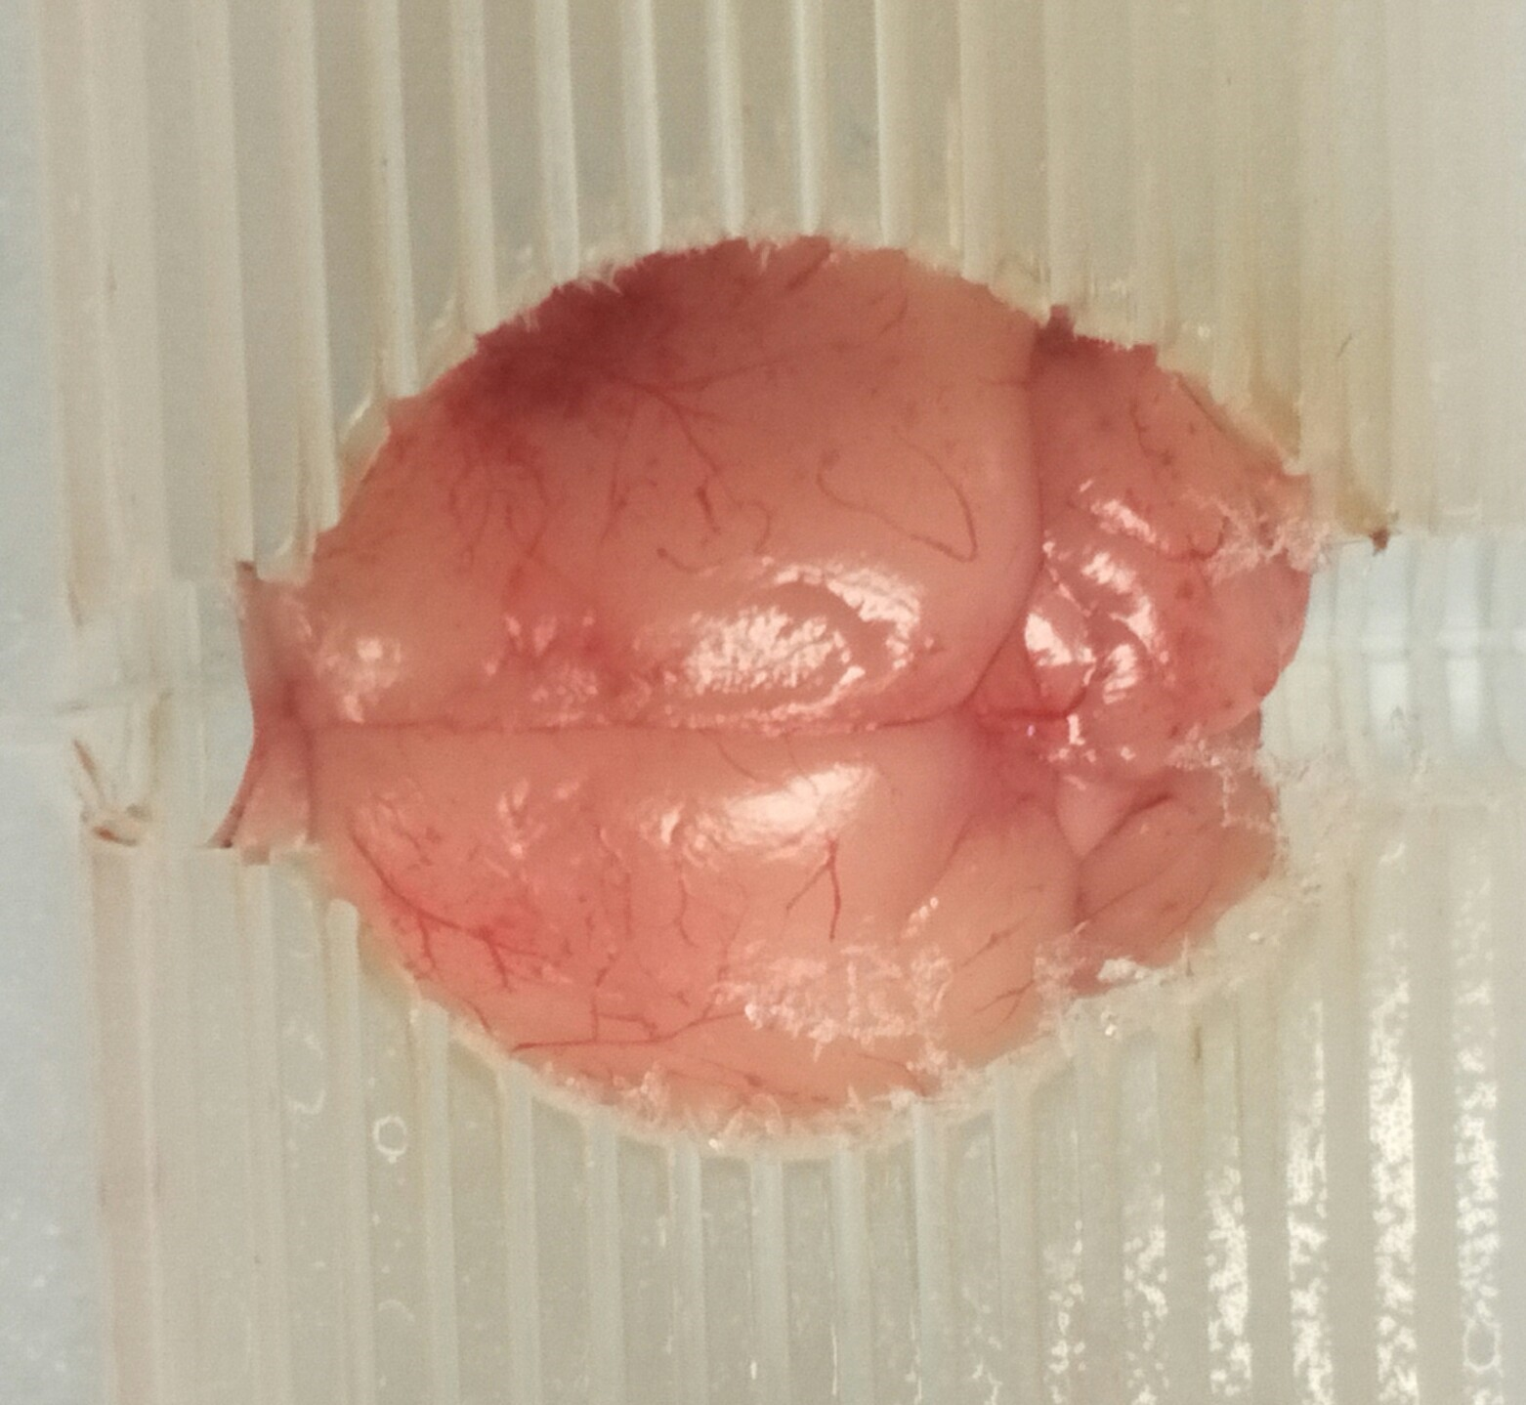
Mouse ID | KX0571
Date of surgery | 11/4/2020
Date of Mortality | 11/9/2020
Day 2 MRI | Yes
Day 7 Behavior | No
Received all the intended treatments | Yes
Visible signs of hemorrhage | Yes

